Slide 1


Project Progress Report (OBKMS)
Viktor Senderov (@vsenderov)
Bulgarian Academy of Sciences/ Pensoft, Sofia Bulgaria
Advisor: Prof. L. Penev
PhD Financed through the EU Marie-Sklodovska-Curie Program
Grant Agreement Nr. 642241

Slide 2
PhD project plan published as a RIO paper
doi: 10.3897/rio.2.e775

Slide 3
Objective
The objective of this dissertation project is to develop and apply a semantic model and algorithms supporting knowledge extraction from biodiversity literature and its management in a semantic database.

Slide 4
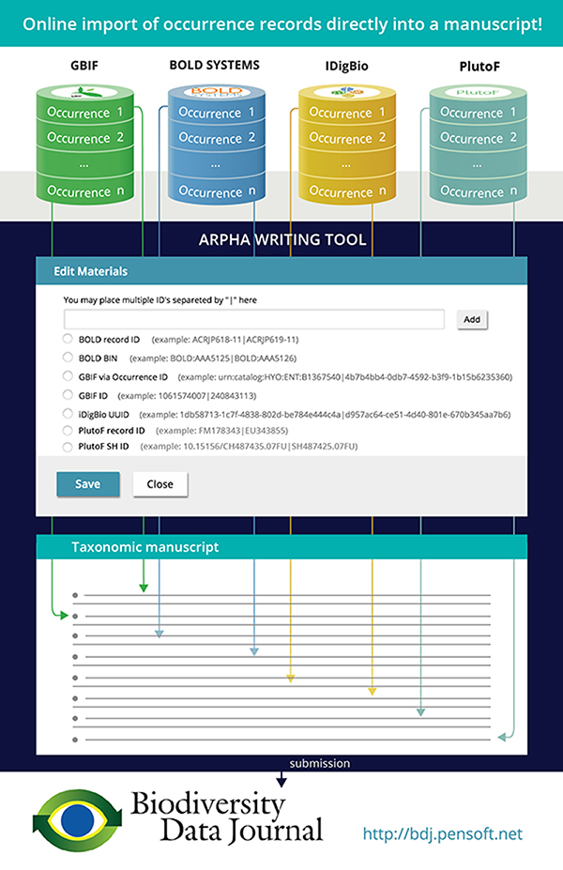
Progress so far 2015-2016
Wrote software allowing for the automated import of specimen records from GBIF, BOLD Systems, iDigBio, PlutoF into Pensoft’s ARPHA system
Wrote software allowing for the automated import of data papers into Pensoft’s ARPHA
Participated in dissemination of these workflows through various blog posts, presentations and webinars

Slide 5
Symposium Attendance
Conference EU-BON, 1 – 4 June 2015, Cambridge, UK: participated in seminars and workgroups.
Conference EMODNET, 8 – 9 June 2015, Crete, Greece: participated in workgroups: upcoming paper (second authorship) in RIO Journal: “EMODnet Workshop on mechanisms and guidelines to mobilise historical data into biogeographic databases”
Conference BEXIS, 9 – 19 July 2015, Jena, Germany: participated in seminars and workgroups.
6-th international Barcode of Life conference, 18 - 21 Aug. 2015, Guelph, Canada: did not participate but co-authorship of report „Streamlining scholarly publication of Barcode of Life data“.
Kick-off BIG4, 14 – 18 Sept. 2015, Copenhagen, Denmark: Introductory Talk : “Building the Open Biodiversity Knowledge Management System”.
EU-BON Training in Sofia, 22 – 24 March 2015, Talk: “Introduction to the ARPHA System”

Slide 6
What is next for 2016-2017?
Describe flow of biodiversity information as the Introduction to the PhD Thesis; use the examples from the practical experience in 2015-2016.
Lay the groundwork for information extraction from biodiversity literature by developing a semantic model (ontology) – 1’st major publication
Develop an algorithm for parsing materials citations based on repeated patterns – 2’nd major publication
These two major publications will serve as the basis of the dissertation.

Slide 7
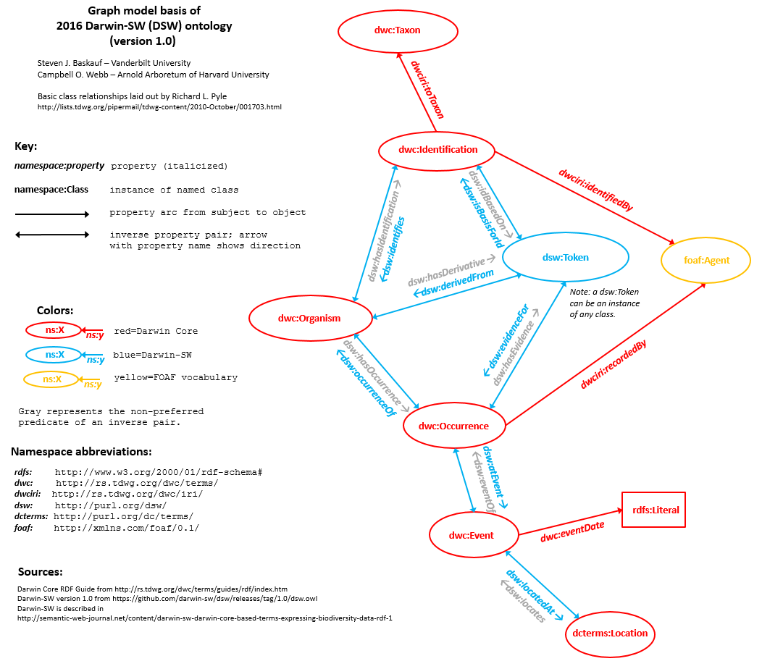
“A semantic model supporting information extraction from biodiversity literature”
OWL Ontology (Web Ontology Language)
Bibliographic classes (e.g. Treatment) linked to and taxonomic classes (e.g. Taxon Concept) via properties
Generation of named RDF graphs (quads) in the form of nano-publications from taxonomic papers
Storage of RDF in a graph database

Slide 8
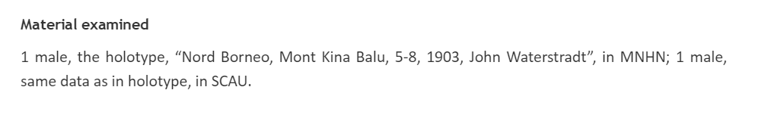
“An algorithm for parsing materials citations based on repeated patterns”
dwc:lifeStage
dwc:year
dwc:collectionCode
dwc:typeStatus
dwc:recordedBy
dwc:month, dwc:day
“location”

Slide 9
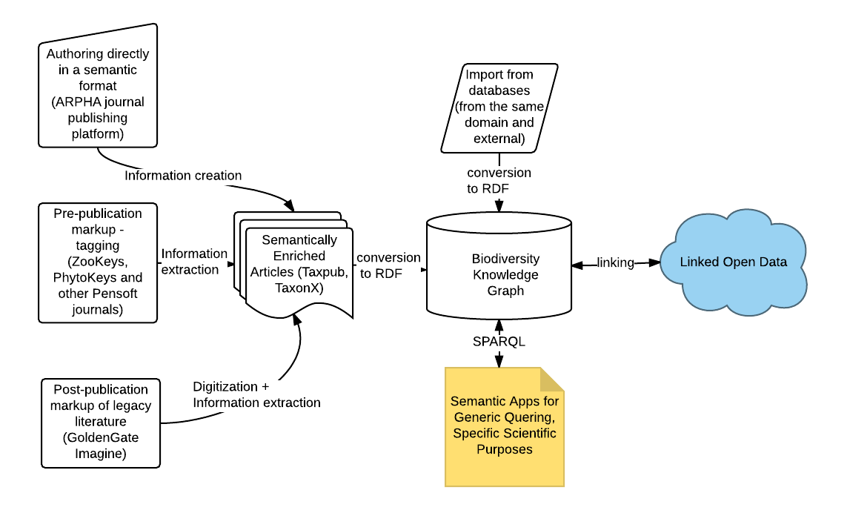
OBKMS Architecture

